Slide 1
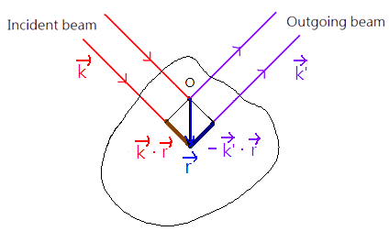
VIII. Kinematical Theory of Diffraction
8-1. Total Scattering Amplitude
The path difference
between beams
scattered from the
volume element
apart is
The amplitude of the wave scattered from a
volume element is proportional to the local
electron concentration ! Why?

Slide 2
Total scattering amplitude F
Define
: periodic function in a crystal
A periodic function can be expanded by
Fourier series!
Any criteria to expand it?

Slide 3
Crystal: periodic
Physical properties function of a crystal
Crystal translation vector
Periodic function → Exponential Fourier Series
u, v, w: integer
Translation vectors of the original crystal lattice
for all
If
h, k, l: integer
Vectors of the reciprocal lattice

Slide 4
always integer
Therefore, is not arbitrary! is reciprocal
lattice, i.e.

Slide 5
(i) when
;
(ii) when
For an infinite crystal
Therefore, diffraction occurs at

Slide 6
The total scattering amplitude F
structure factor

Slide 7
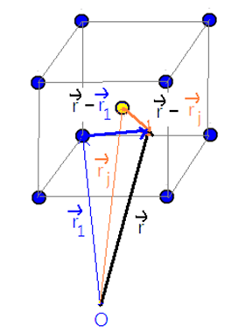
For a unit cell, total electron concentration at
due to all atoms in the unit cell

Slide 8
atomic form factor
The scattering amplitude is then expressed as

Slide 9
8-2. Atomic form factor calculation
The meaning of form factor is equivalent
to the total charge of an atom, which can be
obtained by a direct calculation.
With the integral extended over the electron
concentration associated with a single
atom, set the origin at the atom

Slide 10
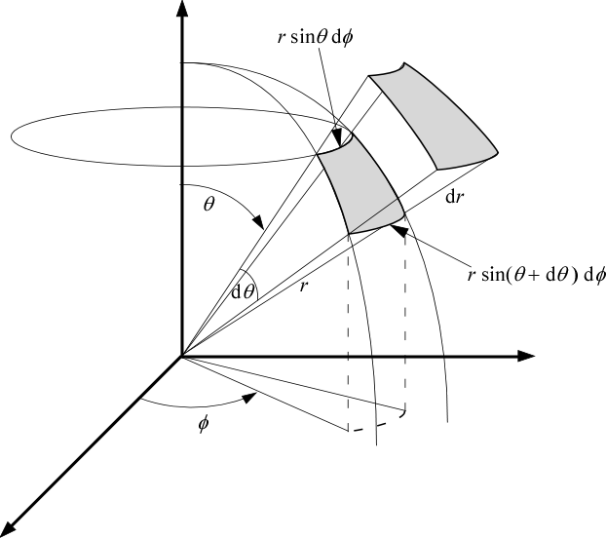
Spherical integration dV = dr(rdθ) (rsinθdφ)
r: 0 - ∞
θ: 0 - π
φ: 0 - 2π
http://pleasemakeanote.blogspot.tw/2010/02/9-derivation-of-continuity-equation-in.html

Slide 11
= 2
θ
assume

Slide 13
depends on G
(chapter 7)
When
total number of
electron in an atom
Tabulated
Function of element and diffracted angle

Slide 14
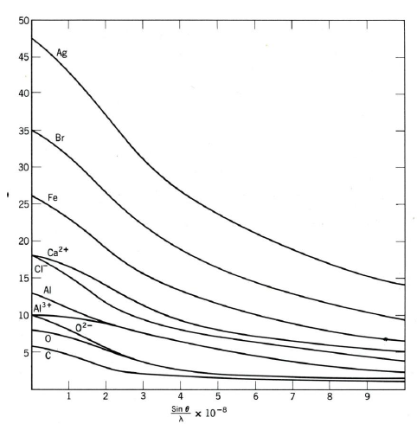

Slide 15
Example:
Si, 400 diffraction peak, with Cu Kα (0.1542 nm)
0
0.1
0.2
0.3
0.4
0.5
0.6
14.0
12.16
9.67
8.22
7.20
6.24
5.31
or

Slide 16
8-3. Structure Factor Calculation
(a) Primitive cell
1 atoms/unit cell;
000 and 100, 010, 001, 110, 101, 011, 111:
equipoints of rank 1; Choose any one will have
the same result!
for all hkl

Slide 17
(b) Base centered cell
2 atoms/unit cell;
000 and 100, 010, 001, 110, 101, 011, 111:
equipoints of rank 1;
½ ½ 0, ½ ½ 1 : equipoints of rank 1;
Two points chosen: 000 and ½ ½ 0.
If h , k is unmixed or h + k is even
If h , k is mixed or h + k is odd

Slide 18
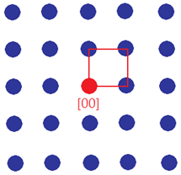
The meaning of the reflection condition
(reflection rule)
Suppose that we have a square lattice
(a) Primitive unit cell：one atom at [00]

Slide 19
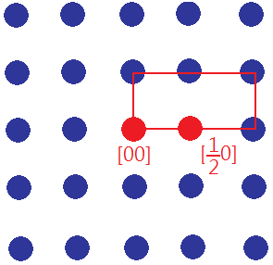
(b) Unit cell：two atoms at [00] [$\frac{1}{2}$0]
If h is even
If h is odd

Slide 20
The reflection conditions remove the lattice
points [odd, 0] in the reciprocal lattice.

Slide 21
Therefore, the meaning of the reflection rule is
to remove the additional lattice points due to the
selection of unit cell.
After the substraction, the reciprocal lattice
structures derived from both cases (primitive
unit cell and unit cell) become the same.

Slide 22
(c) Body centered cell
2 atoms/unit cell;
000 and 100, 010, 001, 110, 101, 011, 111:
equipoints of rank 1;
½ ½ ½: equipoints of rank 1;
Two points to choose: 000 and ½ ½ ½.
If h + k + l is even
If h + k + l is odd

Slide 23
(d) Face centered cell
4 atoms/unit cell;
000 and 100, 010, 001, 110, 101, 011, 111:
equipoints of rank 1;
½ ½ 0, ½ 0 ½, 0 ½ ½, ½ ½ 1, ½ 1 ½, 1 ½ ½: :
equipoints of rank 3;
Four points chosen: 000, ½½0, ½0½, 0½½

Slide 24
If h, k, l unmixed
If h, k, l mixed
(e) close-packed hexagonal cell
2 atoms/unit cell
8 corner atoms: equipoints of rank 1;
2/3 1/3 1/2: equipoints of rank 1;
Choose 000, 2/3 1/3 1/2. (Miller Indices)

Slide 25
2h + k
l
3m
3m
3m±1
3m±1
odd
even
odd
even
0
1
0.75
0.25
0
4f ²
3f ²
f ²

Slide 26
(f) ZnS: four Zinc and four sulfur atoms per
unit cell (8 atoms/unit cell)
000 and 100, 010, 001, 110, 101, 011, 111:
equipoints of rank 1; (S atom)
½½0, ½0½, 0½½, ½½1, ½1½, 1½½:
equipoints of rank 3; (S atom)
¼¼¼, ¾¾¼, ¾¼¾, ¼¾¾: equipoints of rank 4; (Zn)
Eight atoms chosen: 000, ½½0, ½0½,
0½½ (the same as FCC), (Say S atom)
¼¼¼, ¾¾¼, ¾¼¾, ¼¾¾ (Say Zn atom)!

Slide 27
Structure factor of face centered cell

Slide 28
h, k, l: mixed →
h, k, l: unmixed →
when h, k, l are all odd
when h, k, l are all even and h + k + l = 4n
when h, k, l are all even and h + k + l ≠ 4n

Slide 29
Or
h+k+l : odd
h+k+l :odd multiple of 2.
h+k+l: even multiple of 2

Slide 30
8-4. Shape Effect
For a finite crystal, assuming rectangular
volume
For a particular
, if

Slide 32
where
You should already familiar with the function
of
Chapter 4

Slide 33
Consider
1st min occurs at
i.e.

Slide 34
or
Therefore, for a finite crystal, the diffracted
intensity is finite based on the condition below.
I ≠ 0 if

Slide 35
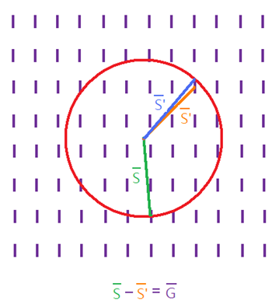
Example: for a very thin sample
Ewald sphere construction
When
$$\vec{S^{′}}−\vec{S}$$
diffraction occurs due
to “shape effect”.

